Slide 1

Network Fundamentals
Network models: the osi guidance part 2

Slide 2
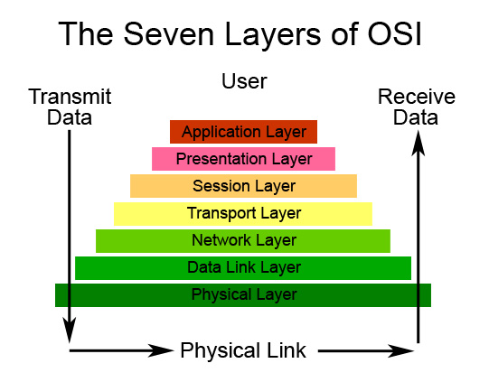
Objectives:
An introduction to network addressing.
Network layer overview.
Data link layer overview.
OSI model data encapsulation.
The complete scenario of data networking.
Challenging test.

Slide 3
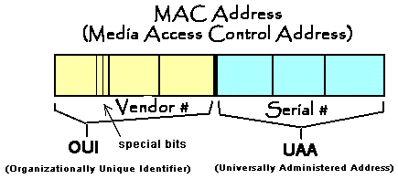
An introduction to network addressing:
Any network-connected PC has two types of addressing:
Logical Addressing.
Physical or hardware addressing.
An IP address like 192.168.1.1, is based on 4 octets in decimal, each octet has 8 binary digits.
A MAC address like 0000.2235.AF0C, is based on 12 hexadecimal digits.
Types of signaling.
How does ARP operate.

Slide 4
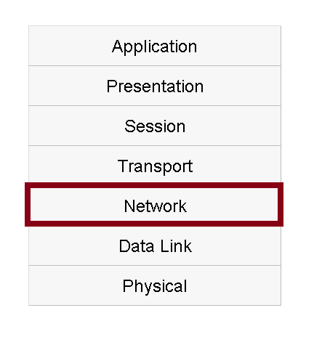
Network layer overview:
It works side by side with the data link layer.
Network layer comes in the play as it determines the path for the packet going from the source peer to the destination one.
It helps the data with getting into the destination network.
The router is operating at this layer.

Slide 5
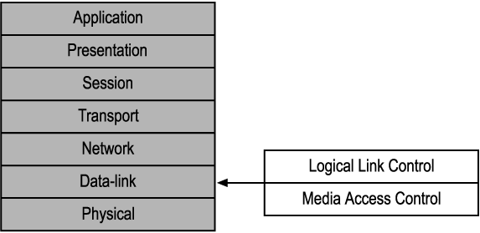
Data link layer overview:
Data link layer consists of two sub layers:
Logical Link Control.
Media Access Control.
It helps the packet with getting into the destination peer.

Slide 6
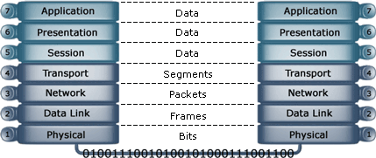
OSI model data encapsulation:

Slide 7
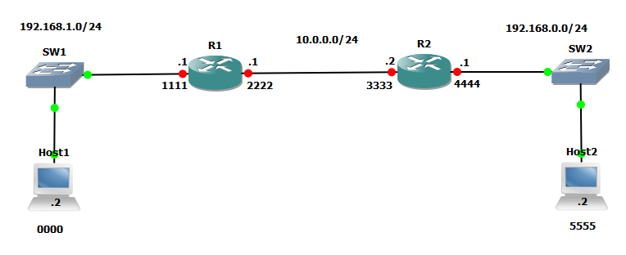
The complete scenario of data networking:

Slide 8
CCNA Routing & Switching
IP Addressing/Subnetting Mastery Part 1

Slide 9
Objectives:
An overview of IPv4 structure.
How can a PC be assigned with an IPv4.
IPv4 classes.
IPv4 types.
Challenging test.

Slide 10
Objectives:
An introduction to network addressing.
Network layer overview.
Data link layer overview.
OSI model data encapsulation.
The complete scenario of data networking.
Challenging test.

Slide 11
CCNA Routing & Switching
Network models: the osi guidance part 2

